Slide 1

Survey Results 1
Hannah DeBruin
Weekly Meeting: Transit Data Subgroup
02/21/23

Slide 2
Survey Response #s
Agency | NTD Monthly Avg | # Responses Calculated | Paper Responses Collected | Qualtrics Responses Collected | Filtered (MN Zip Codes Only) Qualtrics
Prairie Five Riders | 11242 | 76 | 26 | 22 | 10
Morris Transit | 4278 | 76 | 0 | 259 | 118
United Community Transit | 14384 | 81 | 0 + ? | 44 | 16
Central Community Transit | 17797 | 99 | ? | 181 | 132
Transit Alternatives | 7626 | 79 | 10 | 208 | 118
Tri-Cap Transit Connection | 10460 | 109 | 8 | 168 | 115
910 Total Responses
537 Total Responses
Weekly Meeting (02/19/2023)
Hannah DeBruin

Slide 3
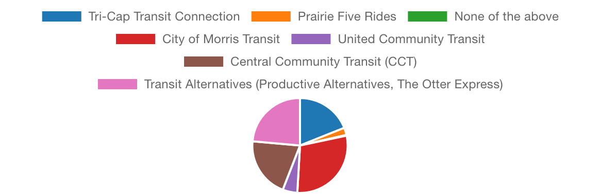
Overall Summary
Overall # Responses: 882 over age 18 (4 who were under 18)
Breakout:
167 Tri-Cap Transit
22 Prairie Five Rides
2 None of the above
258 City of Morris Transit
44 United Community Transit
181 Central Community Transit
208 Transit Alternatives
Weekly Meeting (02/21/2023)
Hannah DeBruin

Slide 4
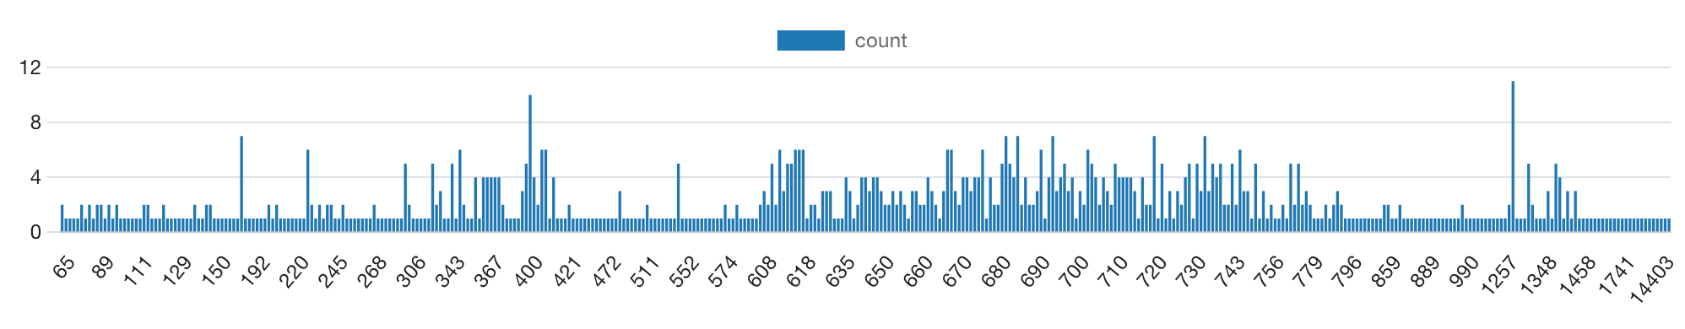
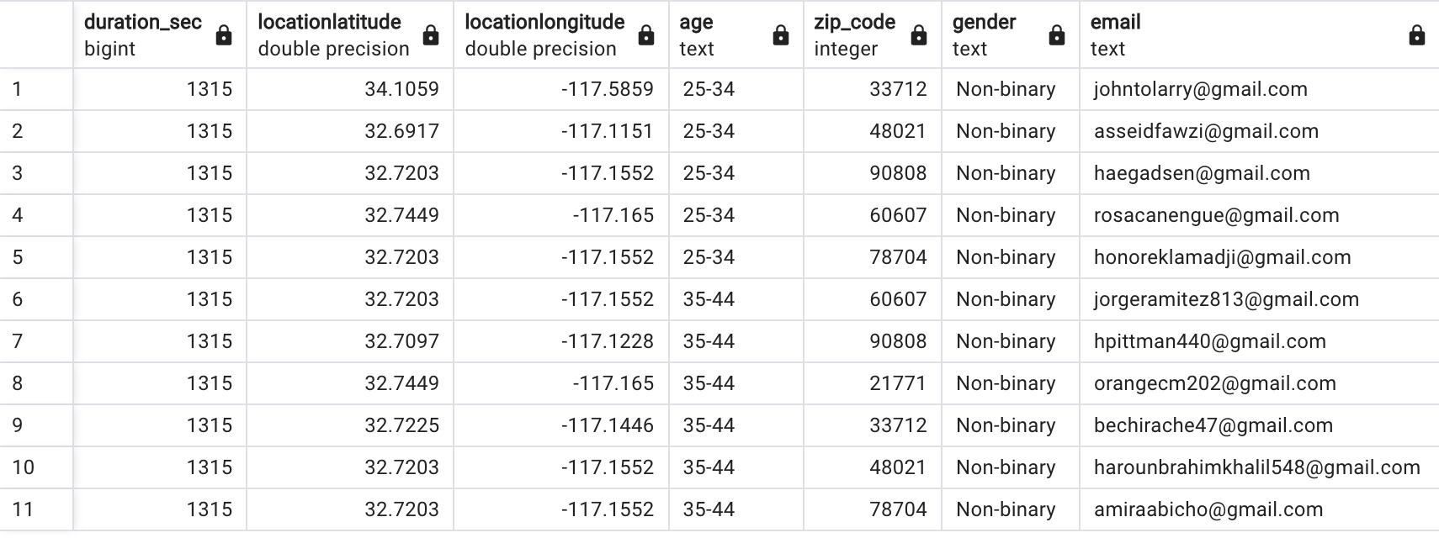

Overall Summary
Avg Response Time: 12 minutes, 21 seconds
weird?
Weekly Meeting (02/21/2023)
Hannah DeBruin
not minnesota?

Slide 5
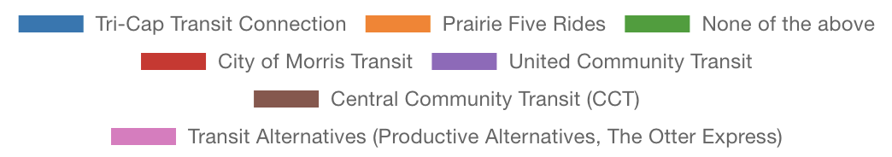
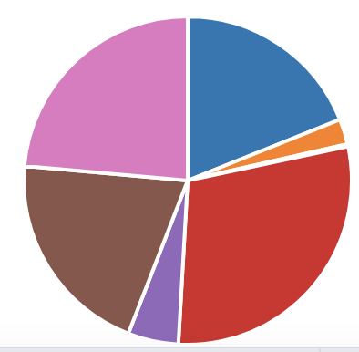
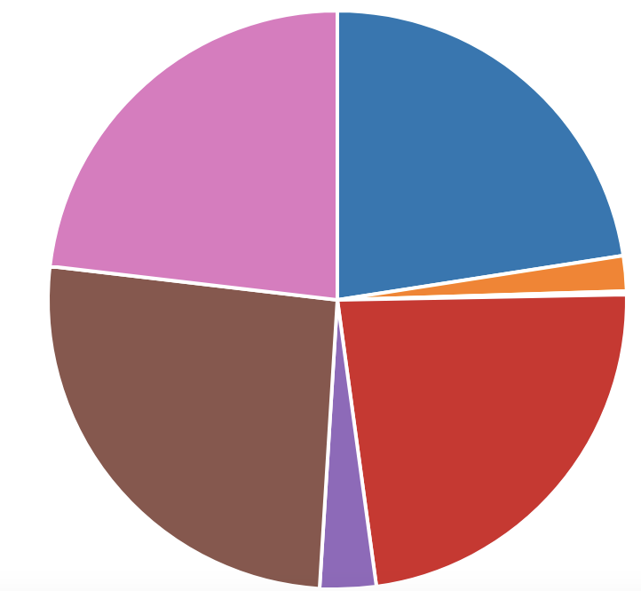
Overall Summary – Only MN Zip Codes
Looking only at MN Zip Codes (https://gisdata.mn.gov/dataset/bdry-zip-code-tabulation-areas)
Overall # Responses: 510
115 Tri-Cap Transit (69% of original)
10 Prairie Five Rides (46% of original)
1 None of the above (50% of original)
118 City of Morris Transit (46% of original)
16 United Community Transit (36% of original)
132 Central Community Transit (73% of original)
118 Transit Alternatives (57% of original)
Before Filtering
After Filtering
Weekly Meeting (02/21/2023)
Hannah DeBruin

Slide 6
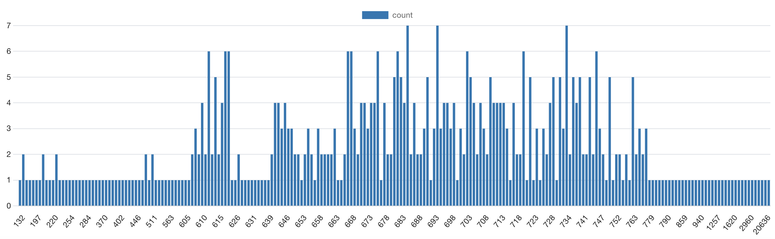
Overall Summary – Only MN Zip Codes
Looking only at MN Zip Codes
Avg Response Time: 14 minutes, 21 seconds
475/510 between 5 minutes and 30 minutes
Weekly Meeting (02/21/2023)
Hannah DeBruin

Slide 7
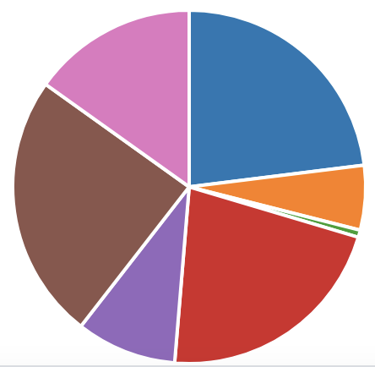
Overall Summary – Only Study Area Zip Codes
Looking only at MN Zip Codes in the Study Area (counties – multipart county boundaries from https://gisdata.mn.gov/dataset/bdry-counties-in-Minnesota)
Overall # Responses: 152
35 Tri-Cap Transit (21% of original)
9 Prairie Five Rides (41% of original)
1 None of the above (50% of original)
33 City of Morris Transit (13% of original)
14 United Community Transit (32% of original)
37 Central Community Transit (20% of original)
23 Transit Alternatives (11% of original)
Before Filtering
After Filtering
Weekly Meeting (02/21/2023)
Hannah DeBruin
Notes:
“When enabled in your survey options, Prevent multiple submissions allows you to detect duplicates and keep them from making their way through the survey. During the first survey session, Prevent multiple submissions places a cookie on the browser. If the same respondent comes back on the same browser and device, without having cleared their cookies, they are flagged as a duplicate.”

Slide 8
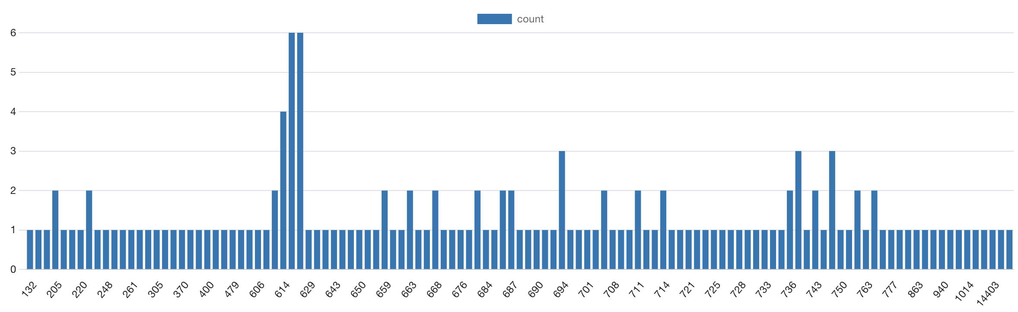
Overall Summary – Only Study Area Zip Codes
Looking only at MN Zip Codes in the Study Area
Avg Response Time: 19 minutes, 14 seconds
131/152 between 5 minutes and 30 minutes
Weekly Meeting (02/21/2023)
Hannah DeBruin

Slide 9
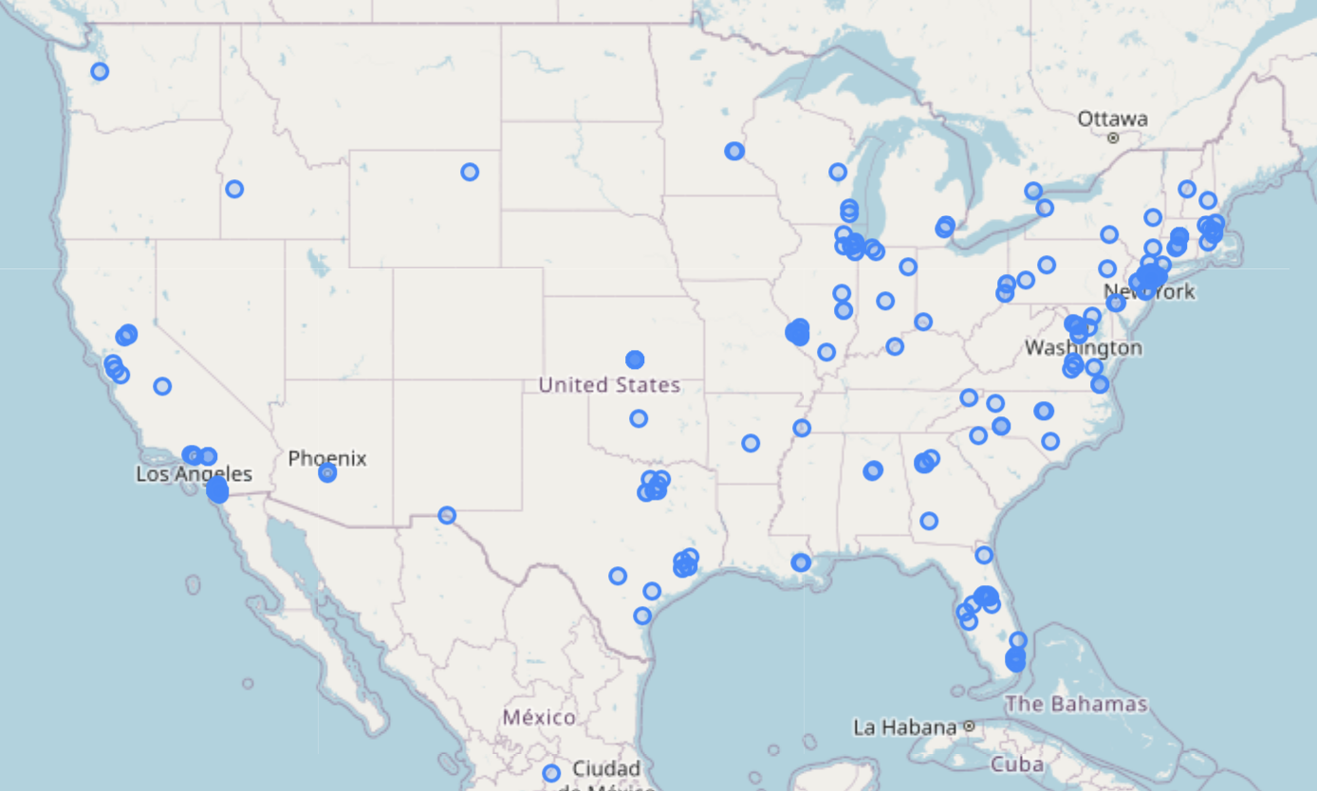
Overall Summary
Non-MN zip code latitude longitude of responses
“the location is an approximation determined by comparing the participant’s IP address to a location database”
Weekly Meeting (02/21/2023)
Hannah DeBruin

Slide 10
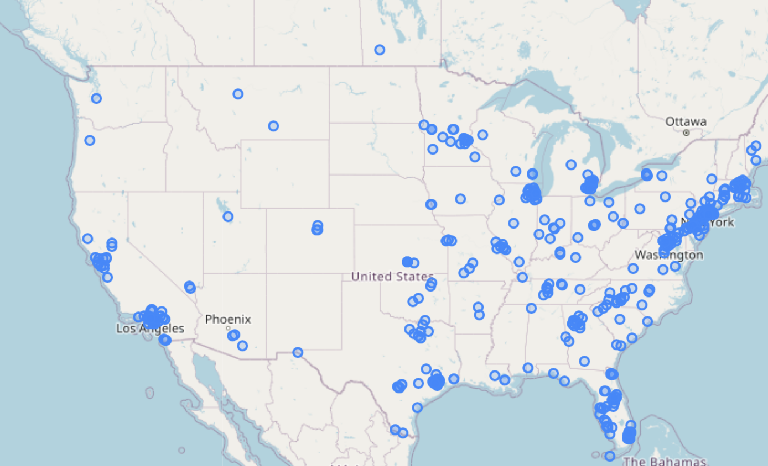
Overall Summary
MN zip code latitude and longitude
“the location is an approximation determined by comparing the participant’s IP address to a location database”
Weekly Meeting (02/21/2023)
Hannah DeBruin

Slide 11
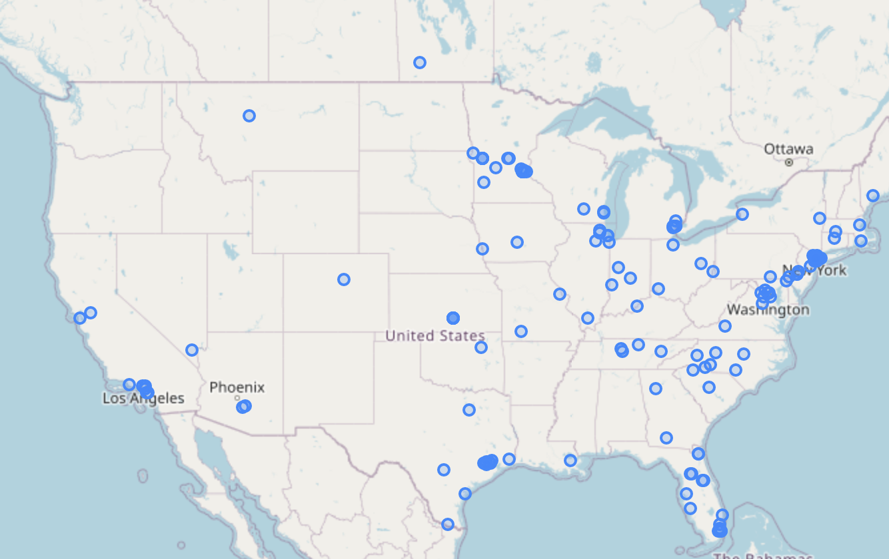
Overall Summary
Study area zip code latitude and longitude
“the location is an approximation determined by comparing the participant’s IP address to a location database”
Weekly Meeting (02/21/2023)
Hannah DeBruin

Slide 12

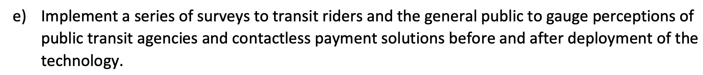
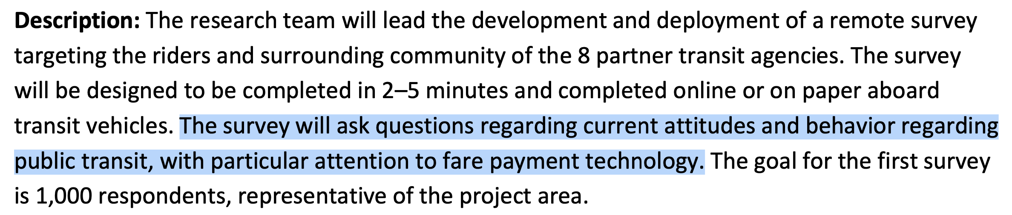
Survey Objectives from Work Plan
Weekly Meeting (02/21/2023)
Hannah DeBruin

Slide 13
Survey Objectives Summarized
Transit usage/behavior, and return post-COVID
Attitudes about transit quality of service
Attitudes about transit COVID safety
Attitudes about fare payment
Attitudes about trip planning
*Will look through data from all MN zip codes, with only survey durations between 5 and 30 minutes
(475 rows total)
Weekly Meeting (02/21/2023)
Hannah DeBruin

Slide 14
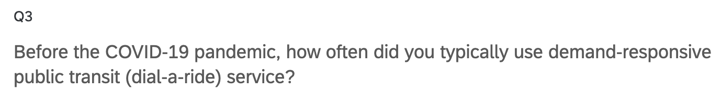
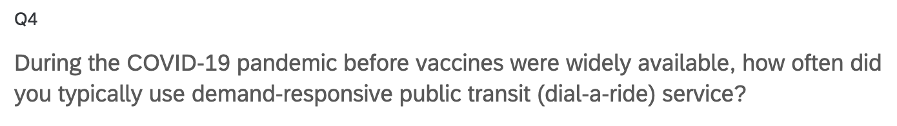
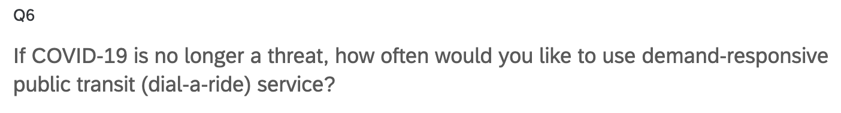
Current Transit Usage/Behavior
Weekly Meeting (02/21/2023)
Hannah DeBruin

Slide 15
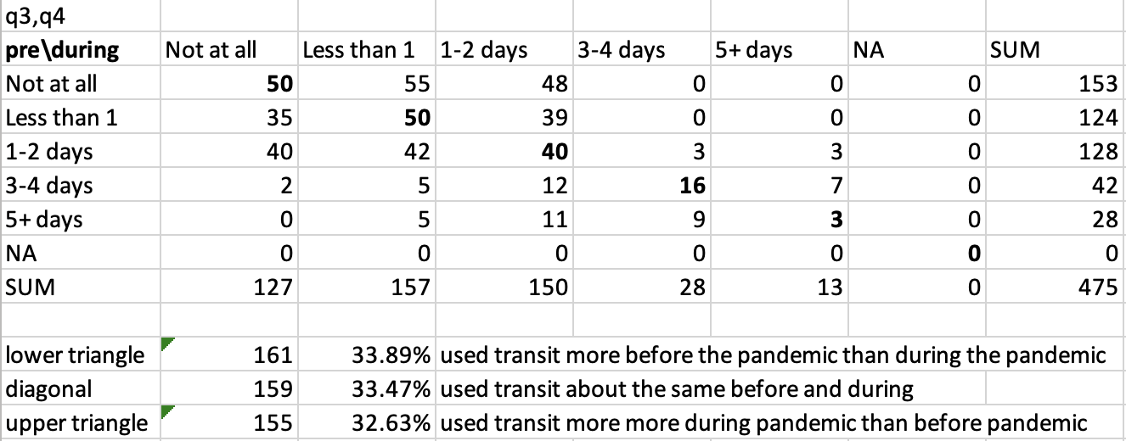
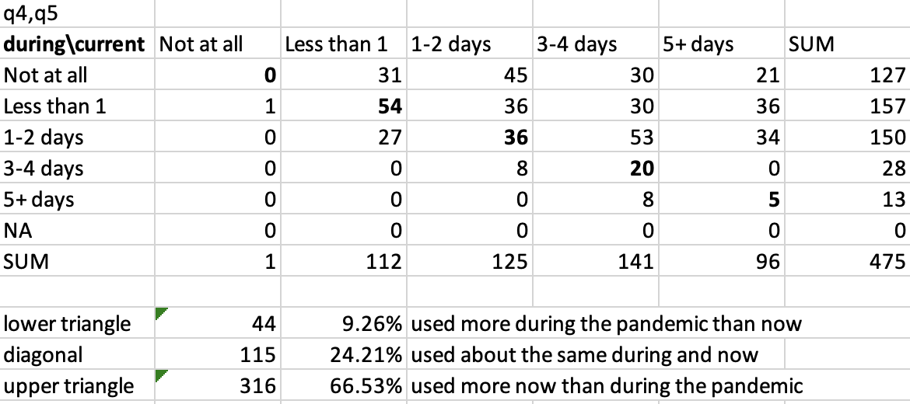
Current Transit Usage/Behavior
Weekly Meeting (02/21/2023)
Hannah DeBruin

Slide 16
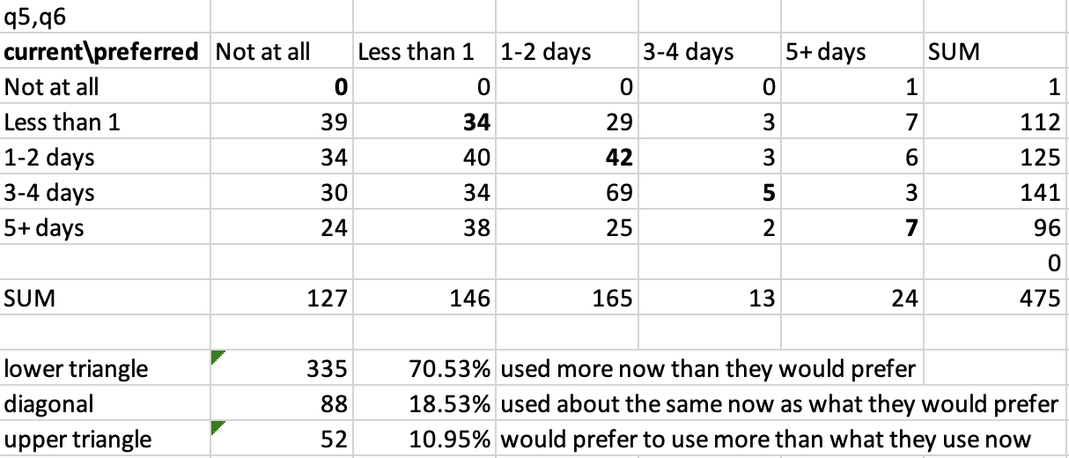
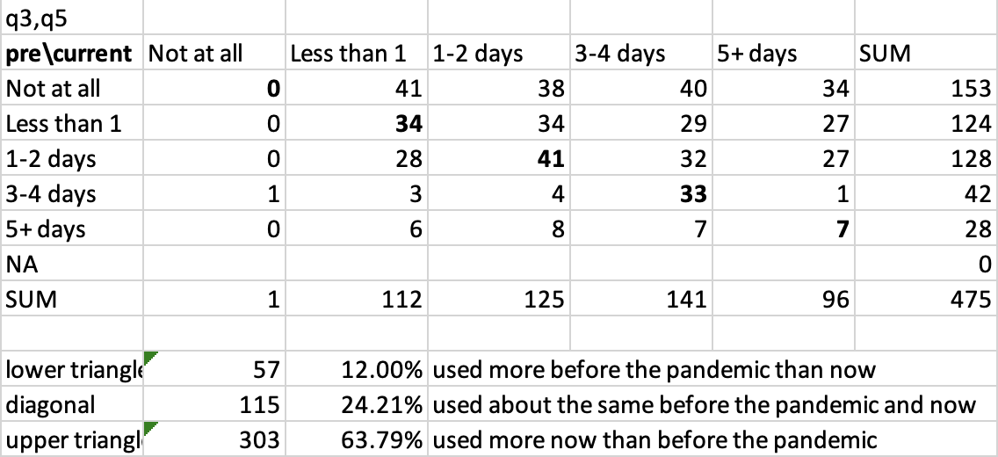

Current Transit Usage/Behavior
want to use transit less?
strong return? – want to verify with NTD data
Weekly Meeting (02/21/2023)
Hannah DeBruin

Slide 17
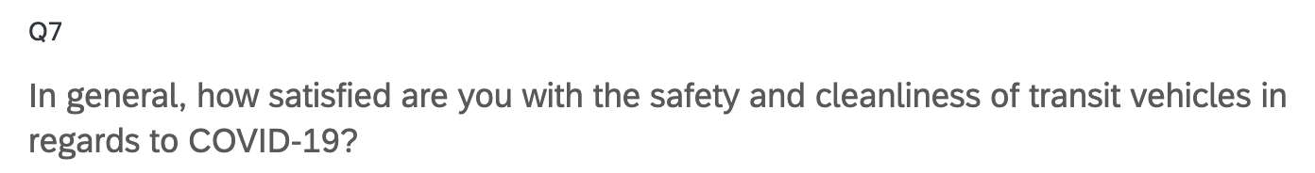
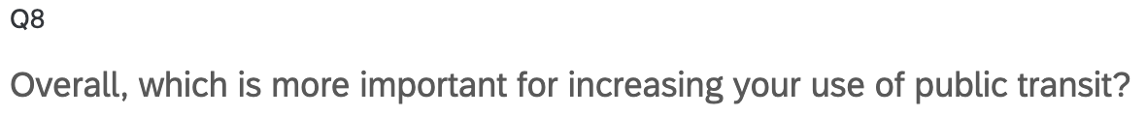
Attitudes about COVID Safety, Quality of Service
Weekly Meeting (02/21/2023)
Hannah DeBruin

Slide 18
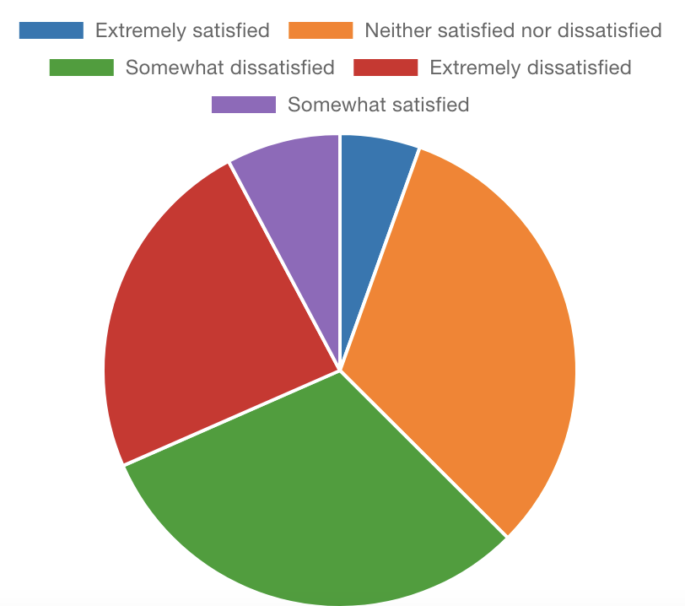
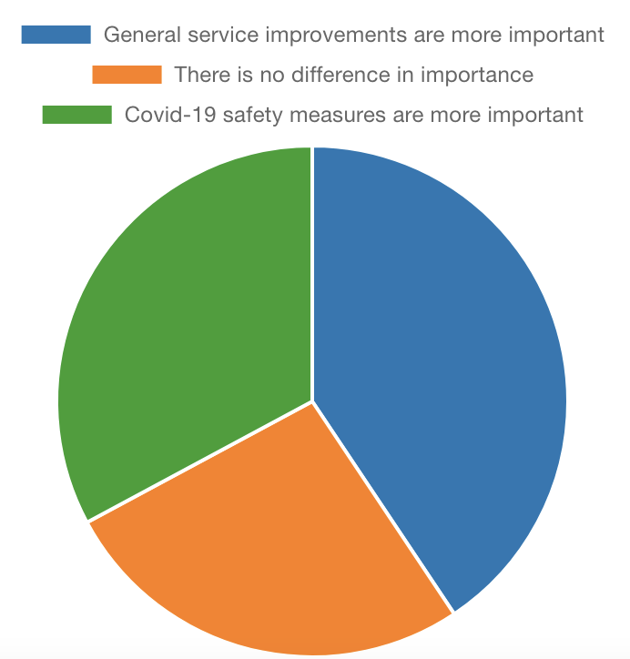
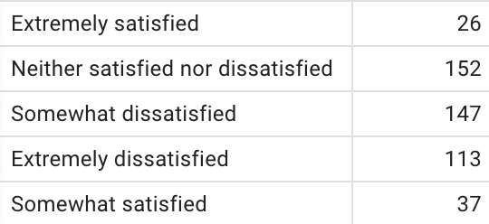
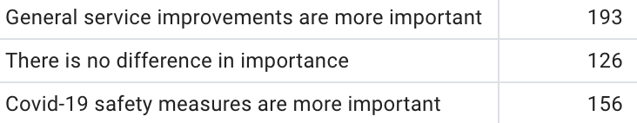
Attitudes about COVID Safety, Quality of Service
Safety and Cleanliness Satisfaction
Service v Cleanliness
Weekly Meeting (02/21/2023)
Hannah DeBruin

Slide 19
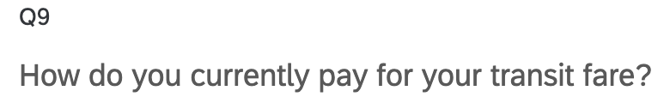
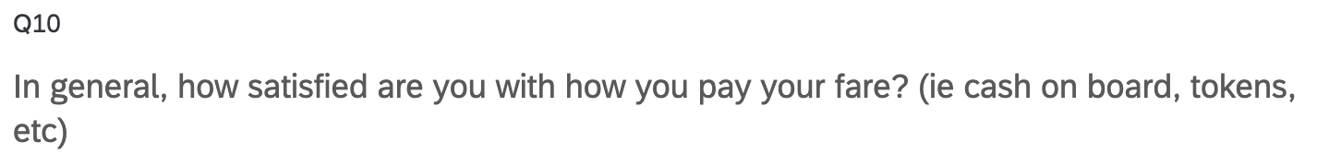
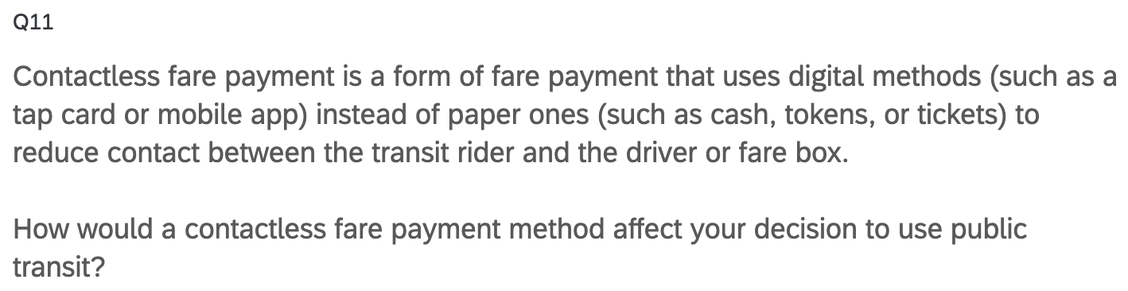
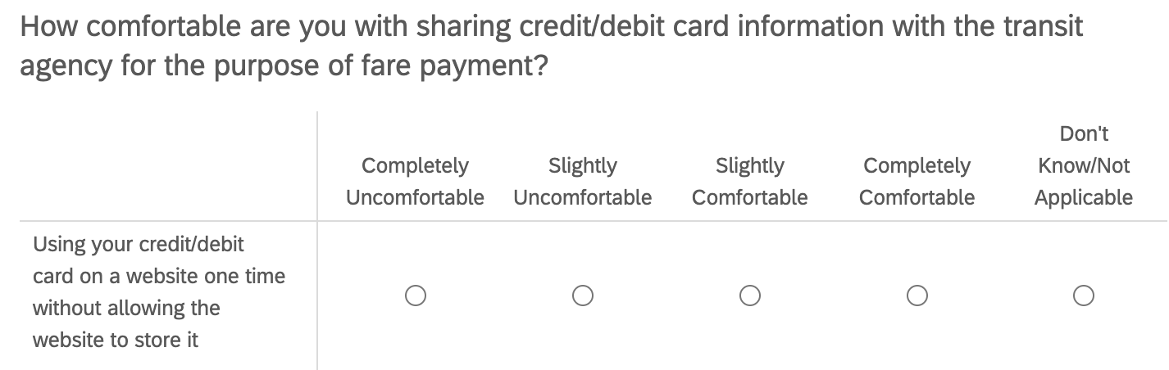
Attitudes about Fare Payment
Q17_1:4
Weekly Meeting (02/21/2023)
Hannah DeBruin

Slide 20
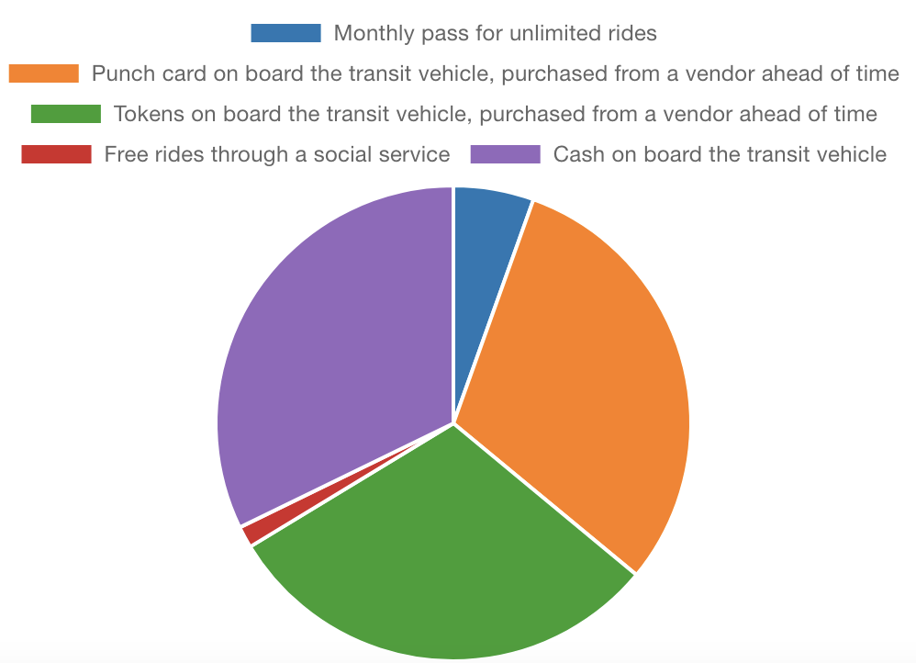
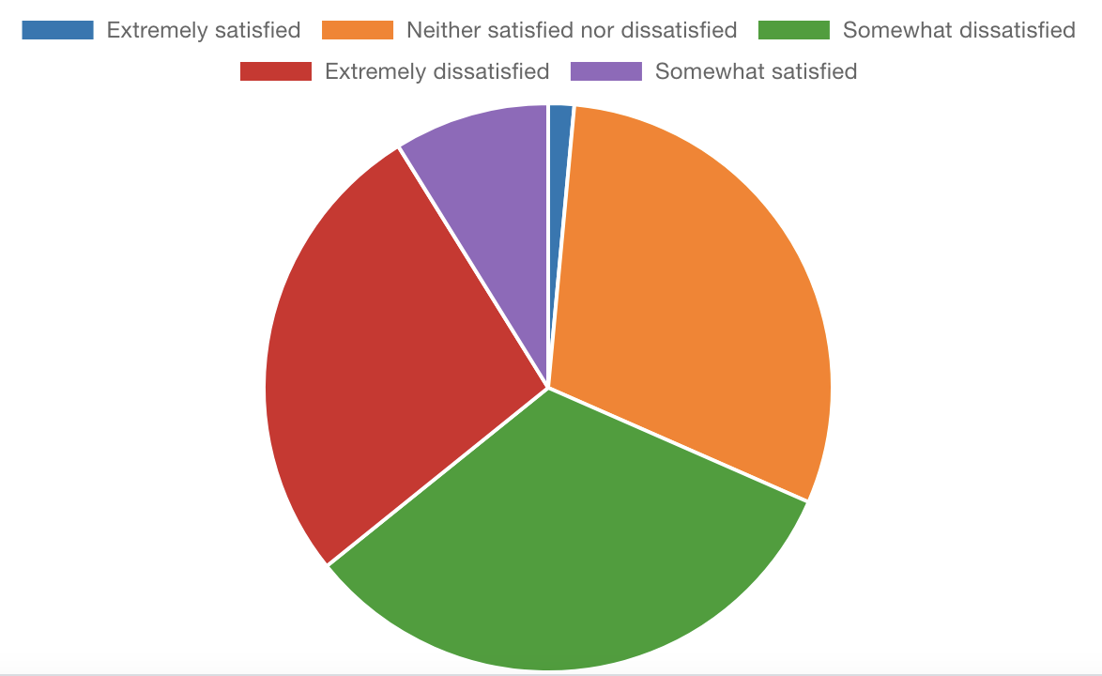
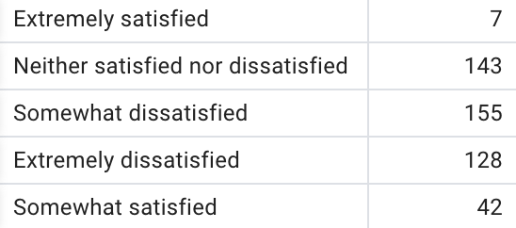
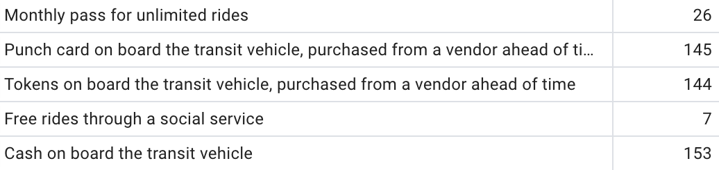
Attitudes about Fare Payment
Current Fare Payment
Satisfaction with Current Fare Payment
*Potential to validate data
comparing transit agency
and fare payment method?
Weekly Meeting (02/21/2023)
Hannah DeBruin

Slide 21
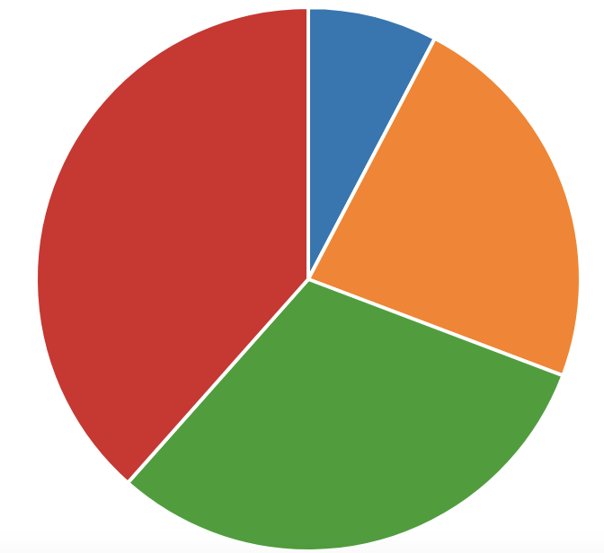
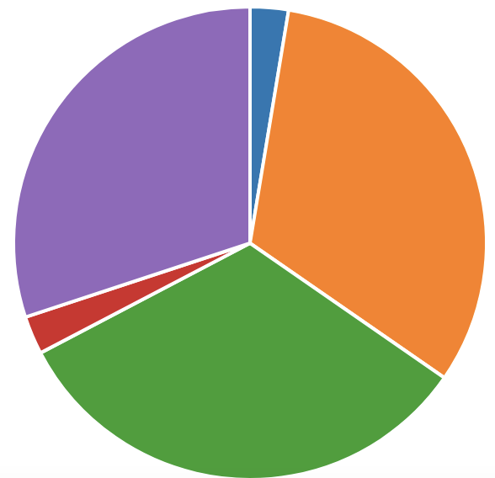
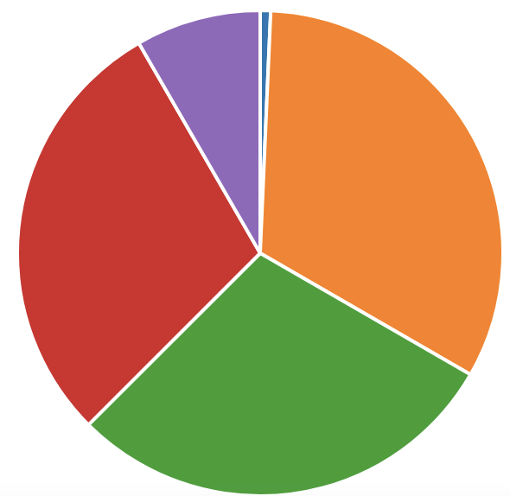
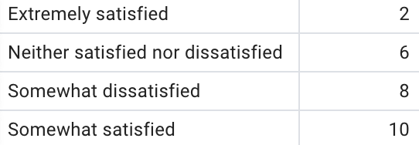
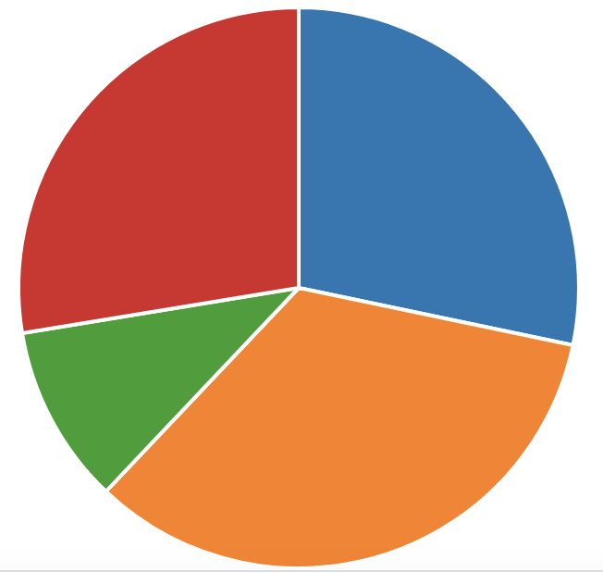
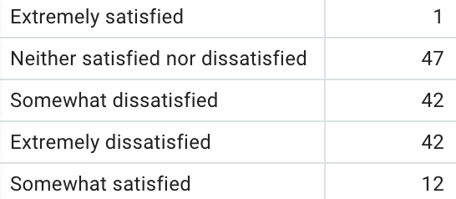
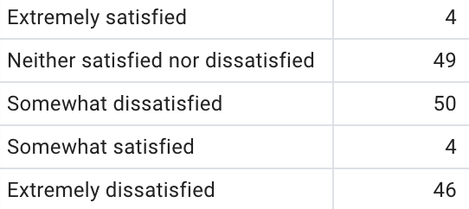
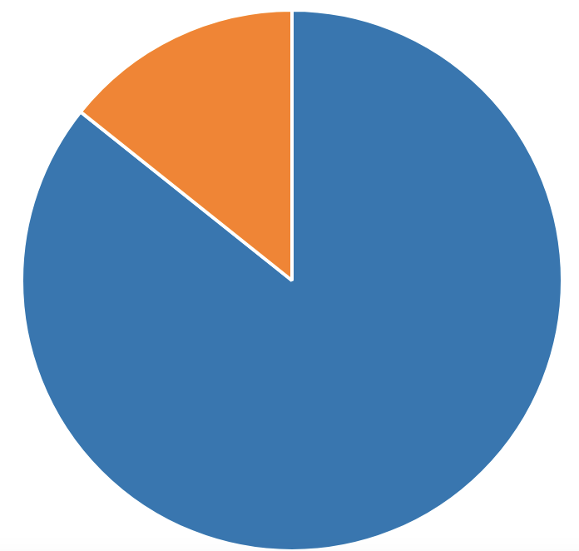
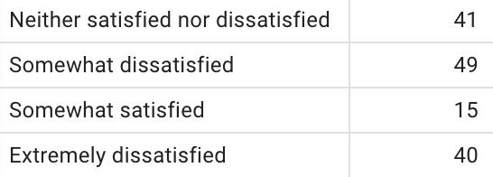
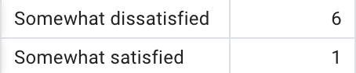
Attitudes about Fare Payment
Monthly Pass
Tokens
Cash on Board
extremely satisfied
extremely satisfied
extremely satisfied
somewhat satisfied
extremely dissatisfied
somewhat satisfied
neutral
neutral
neutral
extremely dissatisfied
somewhat satisfied
somewhat dissatisfied
somewhat dissatisfied
somewhat dissatisfied
Punch Card
Free Rides through
Social Service
extremely dissatisfied
neutral
somewhat satisfied
somewhat dissatisfied
somewhat dissatisfied
somewhat dissatisfied
Weekly Meeting (02/21/2023)
Hannah DeBruin

Slide 22
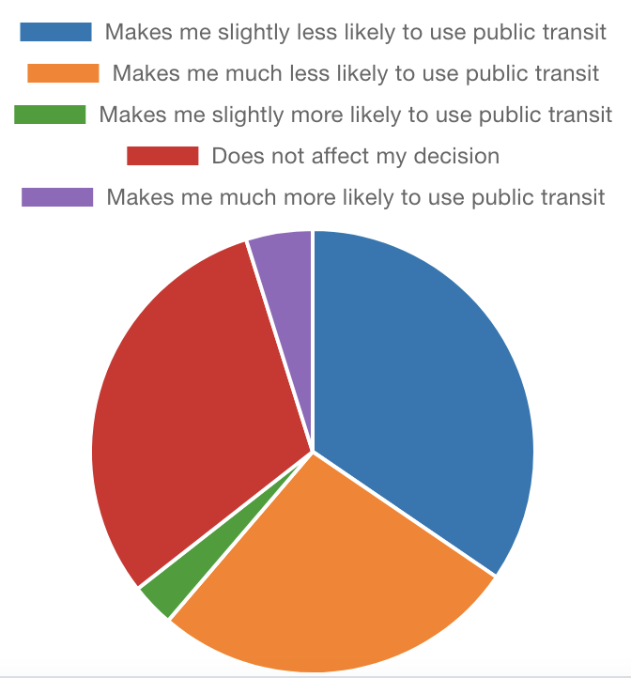
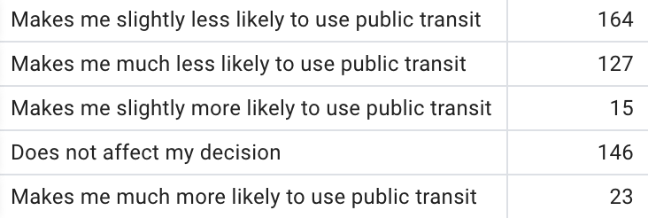
Attitudes about Fare Payment
Weekly Meeting (02/21/2023)
Hannah DeBruin

Slide 23
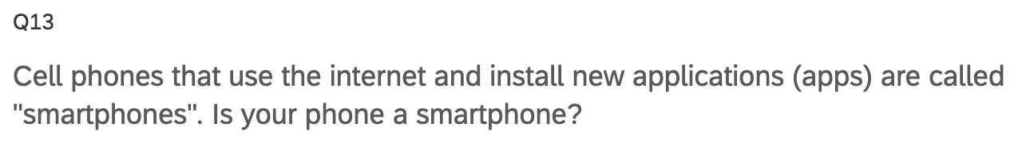
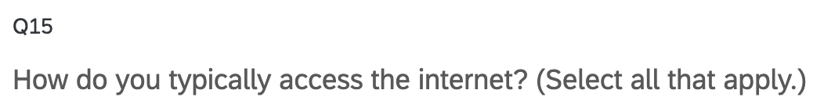
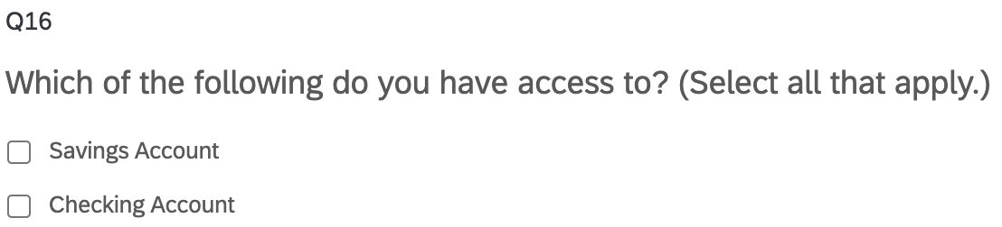

Fare Payment Capabilities
Technology
Payment Method
Weekly Meeting (02/21/2023)
Hannah DeBruin

Slide 24




Fare Payment Capabilities
Q13 - Smartphone?
Q14 - Data Concern
Weekly Meeting (02/21/2023)
Hannah DeBruin

Slide 25



Fare Payment Capabilities
Q16 – Payment Method
Q18 – No Cash Payment Preference
Weekly Meeting (02/21/2023)
Hannah DeBruin

Slide 26



Attitudes about Trip Planning
Weekly Meeting (02/21/2023)
Hannah DeBruin

Slide 27





Sociodemographics
Qualtrics also collects:
-duration to complete
-QR code v link
-lat & long
-datetime started, completed
Weekly Meeting (02/21/2023)
Hannah DeBruin

Slide 28



Sociodemographics
Age
Race/Ethnicity
Weekly Meeting (02/21/2023)
Hannah DeBruin

Slide 29





Fare Payment Attitude Split by Demographic
Age 18-24
Age 35-44
Weekly Meeting (02/21/2023)
Hannah DeBruin

